Slide 1

Introduction to algorithms helper functions; lists
Lecture 4
21 October 2021

Slide 2
What is a helper function in recursive algorithms?
helper function:
is a special subroutine written separately to be called in a main function
Algorithm: func(x,y)
[main]
We
May
Need
Extra
Input
Variables
Algorithm: funcHelper(x,y,m)
Recursive
…
…
…
…
…
…
…
return z

Slide 3
What is a helper function in recursive algorithms?
helper function:
is a special subroutine written separately to be called in a main function
Algorithm: func(x,y)
[main]
We
May
Need
Extra
Input
Variables
Algorithm: funcHelper(x,y,m)
Recursive
1. return funcHelper(x,y,m₁)
Recursive function

Slide 4
What is a helper function in recursive algorithms?
helper function:
is a special subroutine written separately to be called in a main function
Algorithm: func(x,y)
[main]
User Input Window
1. return funcHelper(x,y,m₁)
>> func(x,y)
// the user doesn’t care that an
// extra variable is needed.
// we can’t ask the user to input:
>> func(x,y,m)
// the extra variable may be something
// complex!
// we hide these details in helper function

Slide 5
Example – isPrime(n)
Write a recursive algorithm called isPrime(n) which takes a positive integer and returns True if n is prime and False otherwise.
Prime numbers: 2, 3, 5, 7, 11, 13, …
User Input Window
2,3,4,5,6,7,8,9,10,11,12,13,14,15,16
17
extra variable
we need!
n
>> isPrime(17)
m
>> TRUE
>> isPrime(170)
17%m=0
return FALSE
>> FALSE
base case:
m=2
return TRUE

Slide 6
Example – isPrime(n)
Algorithm: isPrimeHelper(n,m)
Requires: two positive integers n>m>0
Returns: True or False
Algorithm: isPrime(n) [main]
Requires: one positive integers n>0
Returns: True if n is prime, False otherwise
1. if (n%m)==0 then
2. return FALSE //base case
3. elseif (m==2) then
4. return TRUE //base case
5. else
6. return isPrimeHelper(n,m-1)//recursive call
7. endif
8. end
1. return isPrimeHelper(n,n-1)
Initialise m
You trace it for isPrime(17)

Slide 7
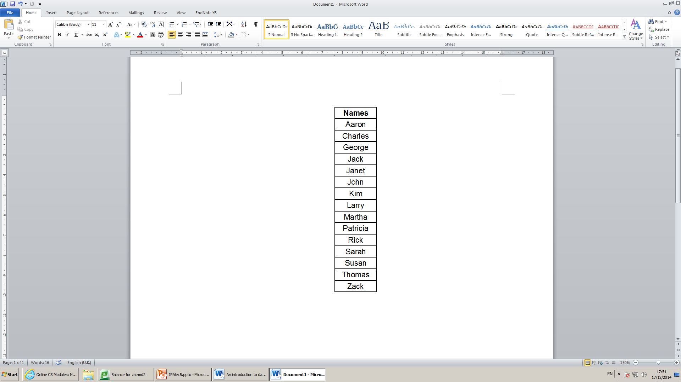
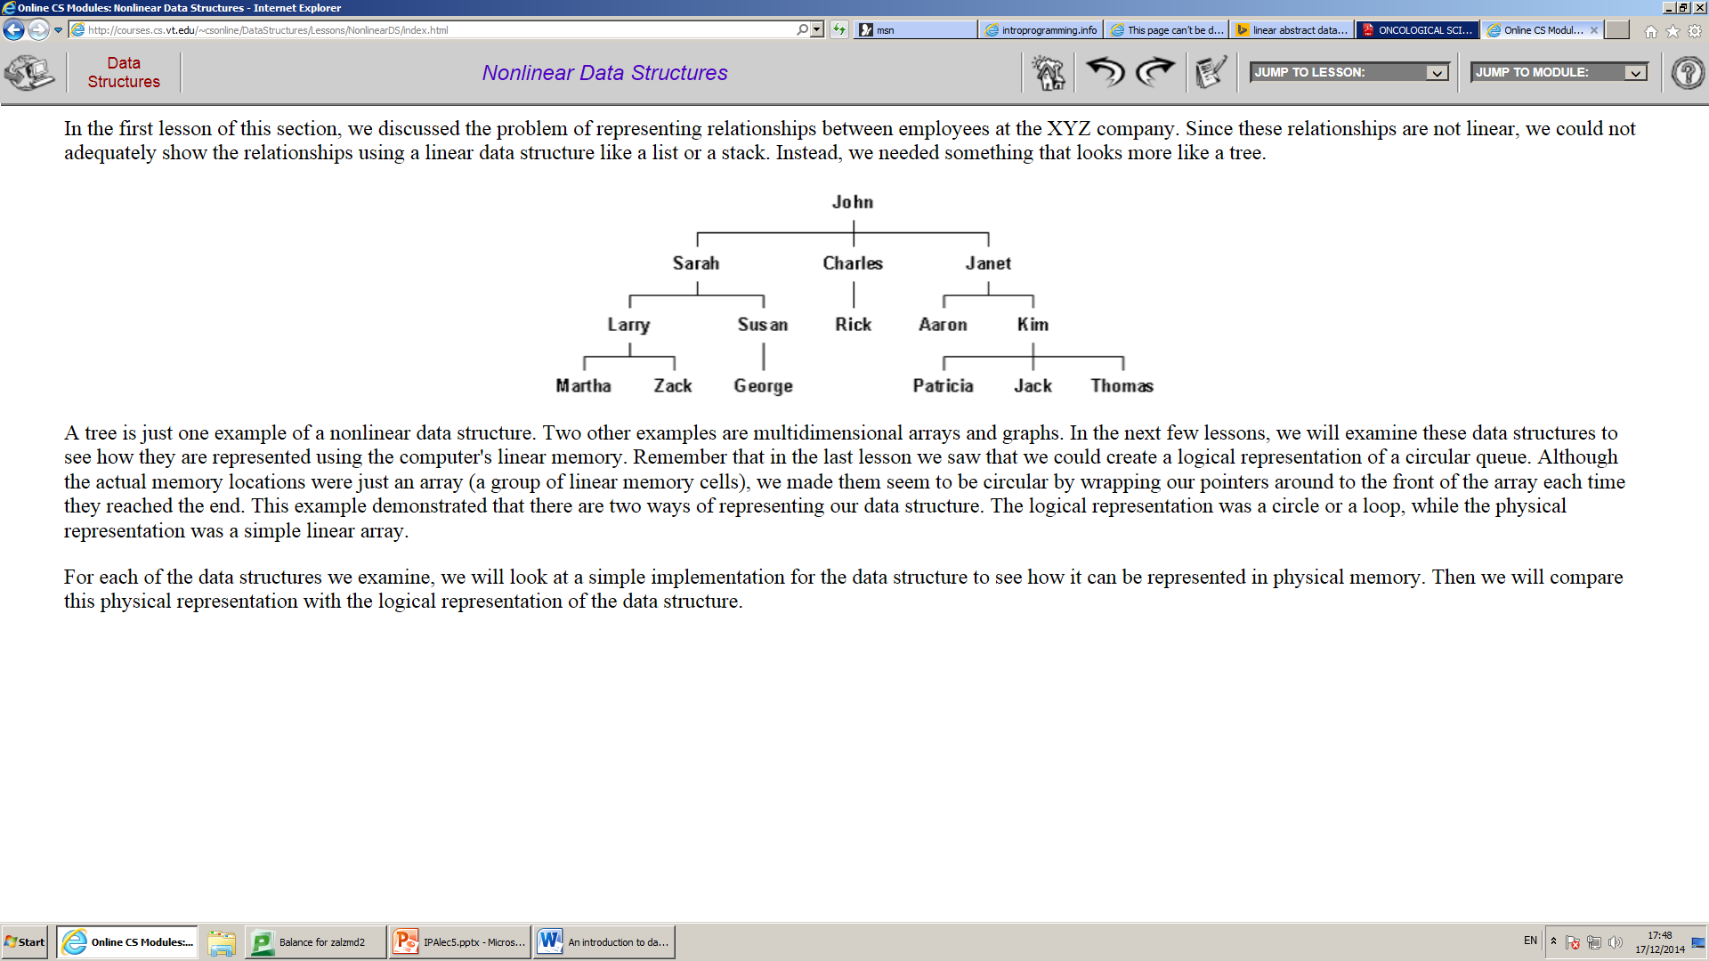
Data structures
Data structures are a way of organizing data items .
Data structure mainly specifies : 1. Organization of data.
2. Accessing methods
Data Structures can be two types Linear and Non Linear.

Slide 8

Lists: introduction
A List is a linear data structure.
Add an element to a list from front .
Delete an element from the list from front .
Point to Note : Addition and deletion of an element is only from front or head of the list. Think of a stack of books!
Front
End
First In Last Out (FILO)

Slide 9


Examples of lists
The empty list
The list with just [6]
The list [2,6]
The list [9,2,6]

Slide 10
The lists slogan
A list is either
empty
or built by adding an element to a shorter list.

Slide 11

Building/making lists
Two new keywords (specific to lists)
nil creates an empty list: Let List1 = nil

Slide 12
Building/making lists
Two new keywords (specific to lists)
cons(x, list_Name) builds longer lists by adding x to the front.
To help you remember - cons is short for “construct”

Slide 13
example
cons function always takes two arguments. cons(x, list_name)
First the element to add.
Second is list name into which first argument (x) will be added.
If the second argument is Nil then
The list with just [6] cons(6,Nil)
If the second argument is a list with elements
Makes the first argument the first of the new list
Makes the second argument the rest of the new list
The list with [2,6] cons(2,cons(6,Nil))

Slide 14
Boolean function for lists
The isEmpty function takes a list, and returns a Boolean value
isEmpty(Nil) =
so is empty
isEmpty(cons( 6, Nil)) =
e.g. is not empty.
True
False

Slide 15
Accessing elements of a list
There are two functions that allow us to access list elements:
head(list_name): returns the head (front) element
tail(list_name): chops the head and returns the rest of the list

Slide 16
head
The head function only works on non-empty lists.
Be very careful when you use this function - you must check if the list
isEmpty or not!
It returns the front value stored in the list, i.e. the head of the list.

Slide 17
Examples (head)
Examples:
head(cons(6,Nil)) =
pictorially: head( ) =
head(cons(2,cons(6,Nil))) =
pictorially: head( ) =
6
6
2
2

Slide 18
tail
The tail function only works on non-empty lists.
Again, you must check if the list isEmpty or not!
It returns a list: rest of the list – the part that follows after the head.

Slide 19
Examples (tail)
Examples:
tail(cons(6,Nil)) =
pictorially: tail ( ) =
tail (cons(2,cons(6,Nil))) =
pictorially: tail ( ) =
Nil
cons(6,Nil)=[6]

Slide 20
Practice problem
Explain how you can produce the list [5,9,12,14] using Nil and Cons.
myList = cons(5, cons(9, cons(12, cons(14,Nil))))
head(myList)=
5
tail(myList)=
[9, 12, 14]
tail(tail(myList))=
[12, 14]
head(head(myList))=??
Not possible!!

Slide 21
Recursive algorithms on lists
In order to write recursive algorithms,
you need to figure out the
base case and the recursive formula
Often the base case starts by checking
whether the list is empty or not!

Slide 22
Note: writing algorithms for lists
We write our algorithms for lists using pseudo-codes.
If you’re confused at any stage, you can just draw a list diagram (pictorial tracing).

Slide 23
Think!!
About the following algorithms until the next week’s seminar:
A recursive algorithm that returns the length of a list.
A recursive algorithm that returns the min/max element of a list.
A recursive algorithm that returns the reverse of a list.
Tools you have:
isEmpty
head
tail
cons
myList = [12, 3, 5, 7, 11, 10, 0, 99]
length(myList) = 8
min(myList) = 0
max(myList) = 99
reverse(myList) = [99, 0, 10, 11, 7, 5, 3, 12]

